Slide 1
Project 2 EC2 Disaster Recovery Simulation
Deploy application on EC2
Create EBS snapshot and AMI
Terminate EC2
Restore EC2 using AMI and snapshot
Validate data and application recovery

Slide 2
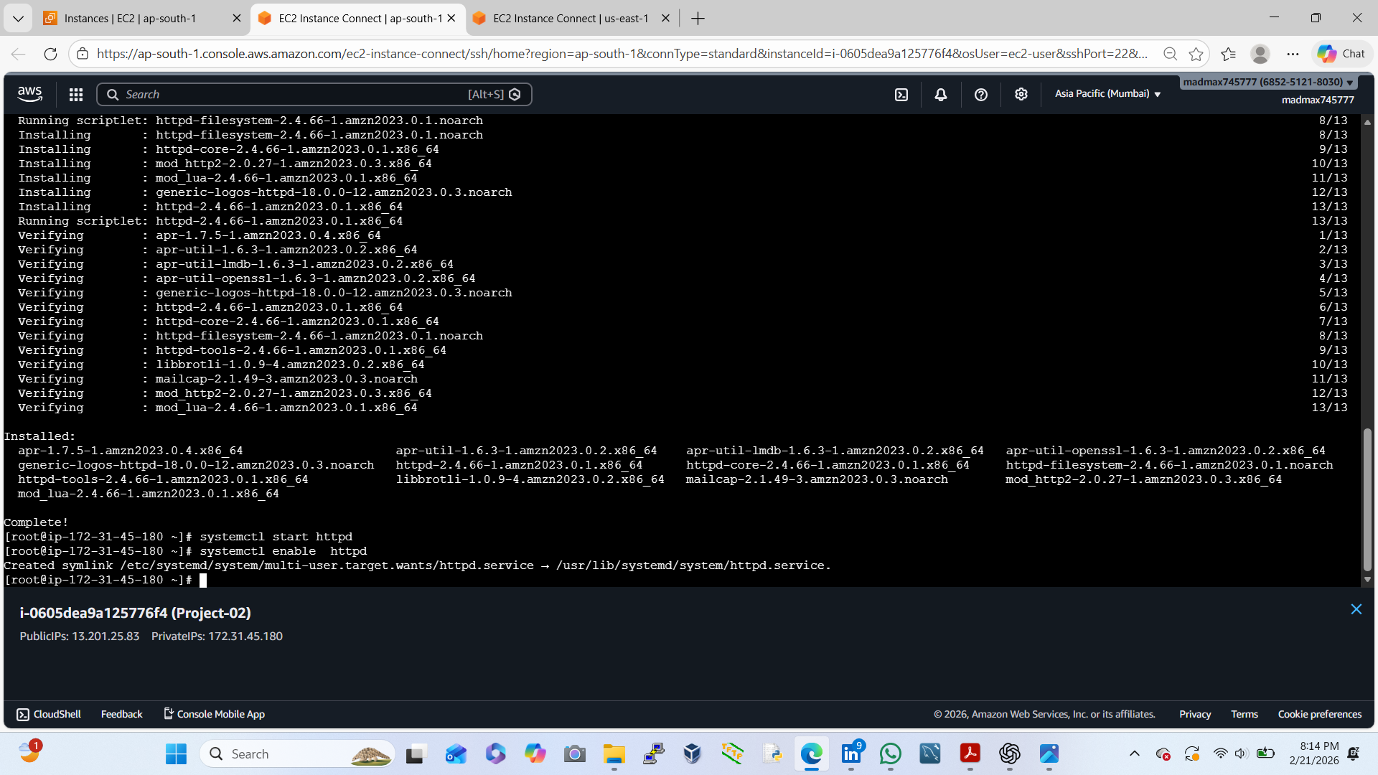
Deploy application on EC2
Select Amazon Linux 2
Instance type: t2.micro (Free Tier)
Create or select Key Pair
Go to EC2 → Launch Instance
Security Group:
Allow SSH (22) from your IP
Allow HTTP (80) from anywhere

Slide 3
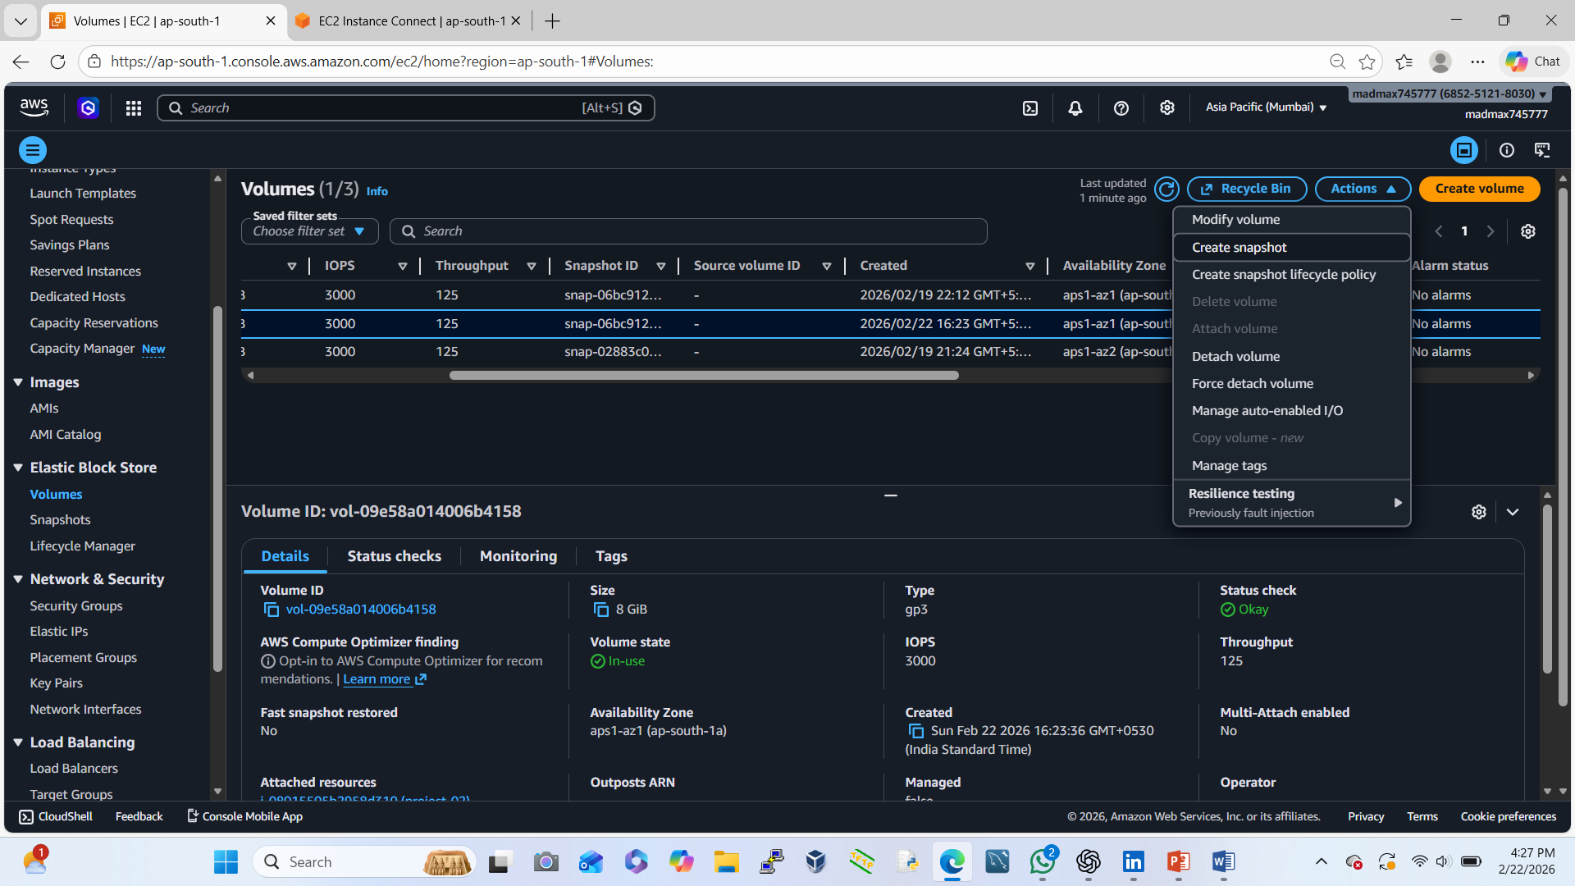
Create EBS Snapshot (Data Backup)
Go to EC2 → Volumes
Select root volume of EC2
Click Actions → Create Snapshot
Name it:
Project2-DR-Snapshot

Slide 4
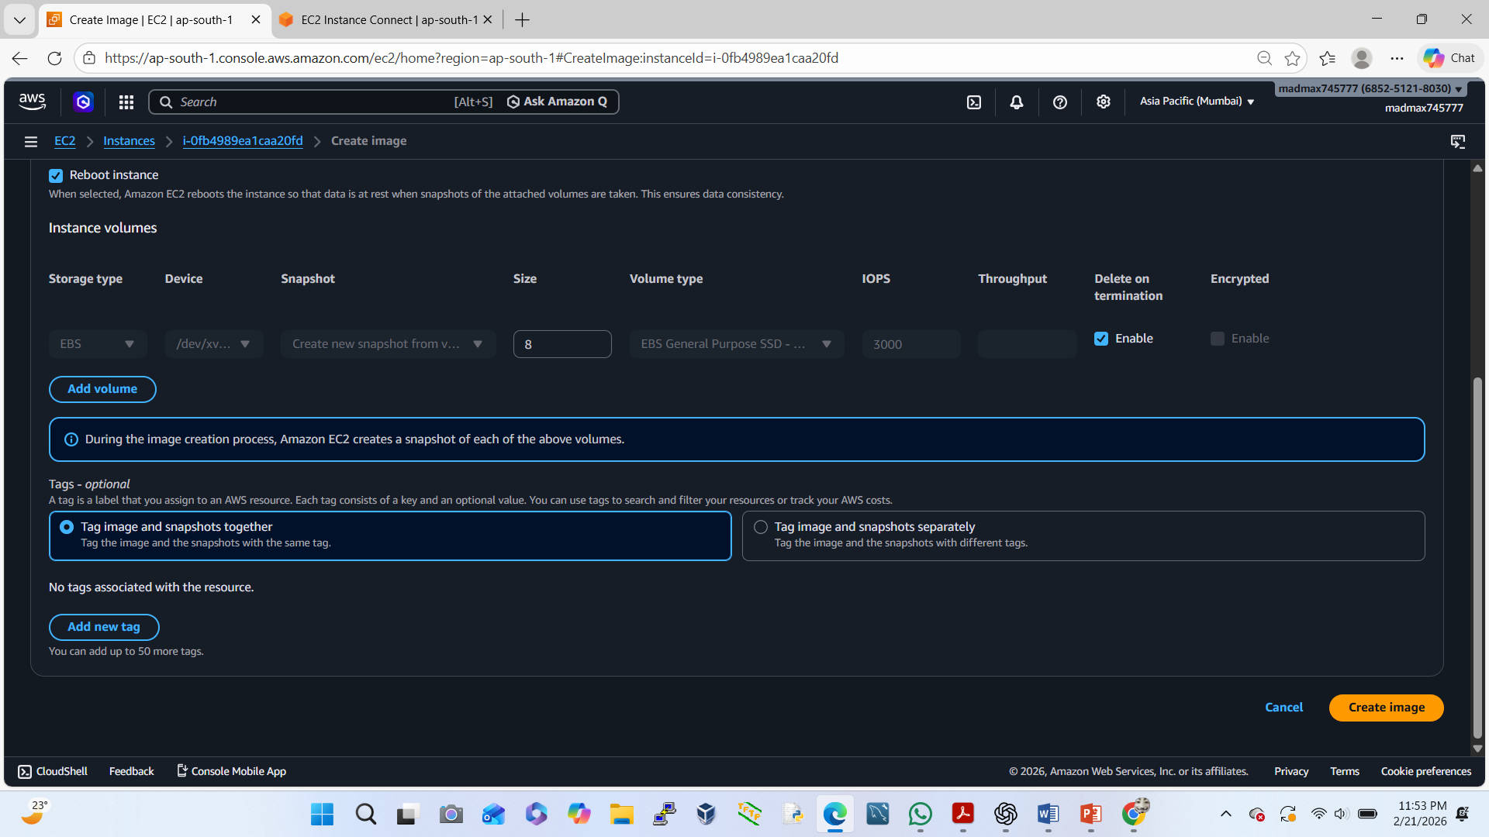
Create AMI (Full Server Backup)
Go to EC2 → Instances
Select our instance
Actions → Image and templates → Create Image
Name:
Project2-DR-AMI

Slide 5
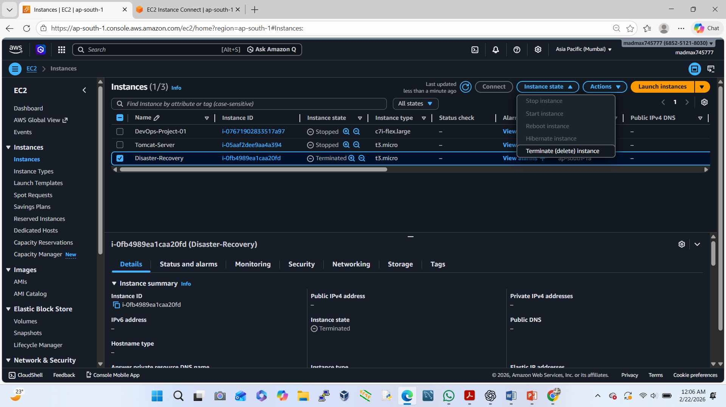
Simulate Disaster (Terminate EC2)
Select EC2 instance
Instance state → Terminate
Confirm
❌ Our server is gone
✅ But backup is safe

Slide 6
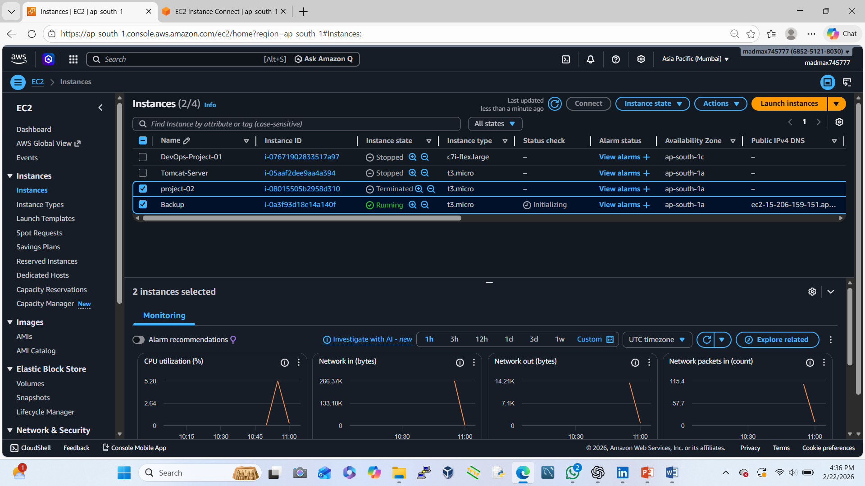
Restore EC2 using AMI & Snapshot
Go to AMIs
Select Project2-DR-AMI
Click Launch Instance
Use same security group & key pair
New EC2 instance is created from backup.

Slide 7
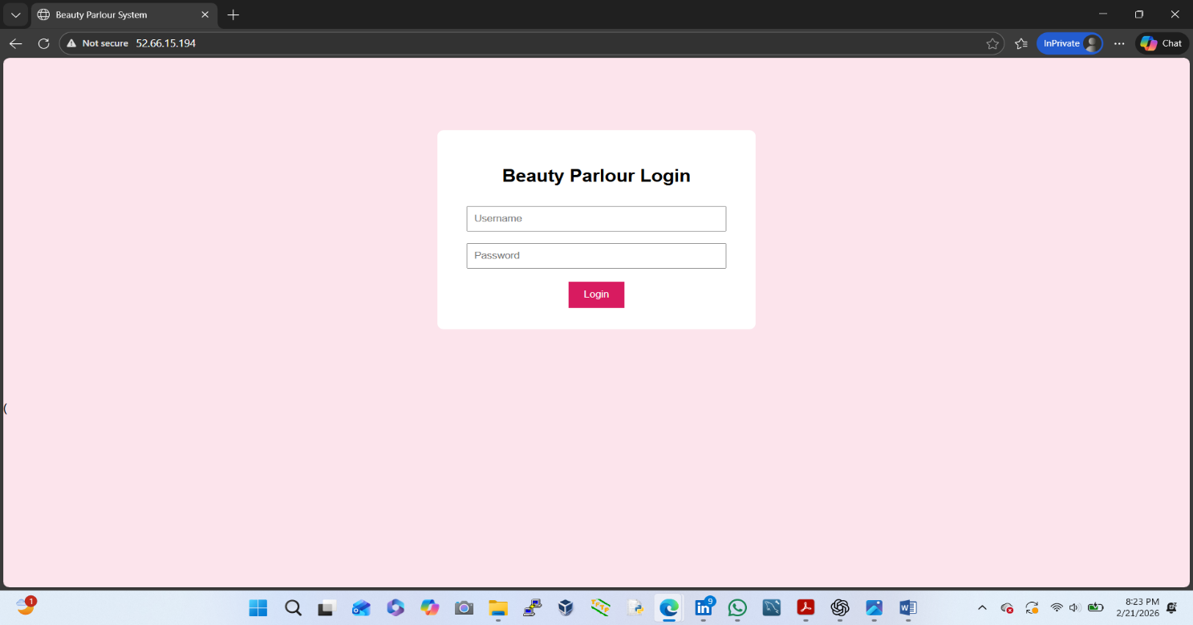
Validate Application & Data Recovery
Check application:
Open browser:
We take New-EC2-Public-IP
http://13.234.186.240

